Slide 1
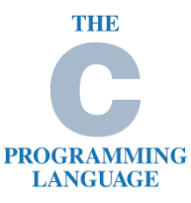
Operators

Slide 2
What is an operators?
An Operator is symbol used to perform operation is given programming language.
In this C Tutorial series, we will discuss about Operators

Slide 3
Types of operators in c language
Arithmetic Operators
Relational Operators
Logical Operators
Bitwise Operators X
Assignment Operators

Slide 4
Arithmetic operators
Operators | Description
+ | Addition
- | Subtraction
* | Multiply
/ | Division
% | Modulus

Slide 5
Relational operators
Operators | Description
== | Is equal to
!= | Is not equal to
> | Greater than
> | Less Than
>= | Greater Than or equal to
<= | Less Than or equal to

Slide 6
logical operators
Operator | Description | Example
&& | Logical AND operator if both the operands are non-zero then the condition is true. | (A && B) is false
|| | Logical OR Operators. If any of these two operands is non-zero then condition become true. | (A || B) is true
! | Logical NOT operator. It is used to reserve the logical state of its operand. If condition is true, then logical not operator will make it false. | !(A && B) is true

Slide 7
Assignment operators
Operator | Description
= | Assign The value in a variable of a c.
+= | Increase the value of the variable and assign the variable.
-= | Decrease the value of the variable and assign the variable.
*= | Multiply and assignment operator.
/= | Divide and assignment operator.

